Slide 1
Criterion 1: Mission
Wednesday, October 18, 2023
Melissa Ramirez, Director of Institutional Effectiveness
Doug Mead, Director of Institutional Research

Slide 2
HLC Criteria for Accreditation
Mission
Integrity: Ethical and Responsible Conduct
Teaching and Learning: Quality, Resources and Support
Teaching and Learning: Evaluation and Improvement
Resources, Planning and Institutional Effectiveness
Each Criterion has Core Components and Sub-Components
Notes:
MR

Slide 3
Criterion 1. Mission
The institution’s mission is clear and articulated publicly; it guides the institution’s operations.
Notes:
DM

Slide 4
Criterion 1. Mission Core Components
1.A. The institution’s mission is articulated publicly and operationalized throughout the institution.
1.B. The institution’s mission demonstrates commitment to the public good.
1.C. The institution provides opportunities for civic engagement in a diverse, multicultural society and globally connected world, as appropriate within its mission and for the constituencies it serves.
Notes:
DM

Slide 5
How is the Mission Connected?
Resources, Planning, and Institutional Effectiveness
Integrity: Ethical & Responsible Conduct
Mission
Teaching & Learning: Quality, Resources and Support
Teaching & Learning: Evaluation and Improvement

Slide 6
TSCC’s Mission, Vision and Core Values
Mission
To provide the highest quality education and training to our students, faculty, staff and community
Vision
Be the model for academic excellence, student-focused service and community engagement.
Core Values
Teamwork
Excellence
Respect
Responsibility
Accountability

Slide 7
Ask Yourself
Is the institution’s mission understood broadly?
Where is the mission statement located?
When and how was the mission developed (the process)? Who was involved, had input?
How did students, faculty, staff and community members become aware of it?
Where is the mission published?
How is the mission reviewed? When? How often? Who is involved in the review to ensure it still fits the purpose for existence?
How does your office, department, or division contribute to TSCC’s mission, vision and core values?
What decisions show your major interest is serving society?

Slide 8
How Can You Help?
Attend Upcoming HLC Information Sessions
Reflect on the Things We Have Done at TSCC in the Past 5 Years
Be Ready to Share Your Reflections
If you don’t know the answer, there is no need to make an answer or guess. It’s okay to say, “I don’t know”.
Remember, this is an opportunity to Tell Our Story – Who we are and what we do!
Notes:
Opportunity for improvement
Demonstrate our strengths and accomplishments

Slide 9
Session | Date | Time | Location
Here’s the Scoop on the next HLC Information Session! Criterion 2: Integrity: Ethical and Responsible Conduct | Wednesday, November 8, 2023 | 4:00 – 5:00 pm | The Neeley
Let’s not wine about HLC! Criterion 3: Teaching and Learning – Quality, Resources and Support | Wednesday, December 6, 2023 | 4:00 – 5:00 pm | The Neeley
Our next HLC Information Session is just rolling with lots of information! Criterion 4: Teaching and Learning -Evaluation and Improvement | Wednesday, January 24, 2024 | 4:00 – 5:00 pm | The Doepker Center, B101
HLC is all that and a slice of Pie! Criterion 5: Institutional Effectiveness, Resources and Planning | Wednesday, January 31st, 2024 | 4:00 – 5:00 pm | The Doepker Center, B101
Don’t get it twisted, the next HLC Information Session is something you do knot want to miss! HLC Accreditation Assurance Argument: Final Campus Review | Wednesday, February 7, 2024 | 4:00 – 5:00 pm | The Doepker Center, B101
Here is the last pizza HLC Information before our HLC site visit! Final Campus Preparation for HLC Comprehensive Site Visit | Wednesday, March 6, 2024 | 4:00 – 5:00 pm | The Doepker Center, B101
Notes:
Upcoming HLC Information Sessions – Please let us know if you’re unable to attend. We can schedule an alternative time to meet.

Slide 10
What’s Next
Become familiar with TSCC’s Preparing for the HLC visit web page: https://www.terra.edu/about_us/accreditation/hlc_visit.php
Criterion One will be available for campus input: November 1, 2023
Take a moment to review TSCC’s website
Next HLC Information Session: Wednesday, November 8, 2023
Student Opinion Survey
    Three Months Prior to the Visit: Email Notification
    Two Months Prior to the Visit: Share Survey Link
    One Month Prior to the Visit: HLC provides results to the institution
Notes:
Website – please take a moment to review the website to ensure the information we are providing is update to date and accurate. Submit a Marketing Request Ticket to make changes to the website.

Slide 11
Recap from last HLC Information Session:
TSCC follows the Open Pathway Accreditation Cycle
Our Quality Initiative Focused on: Program Learning Outcomes and Co-Curricular Assessment
Areas for improvement from last site visit: Institutional Policies and Procedures, Institutional Research, and Outcomes Assessment
Our Comprehensive Site Visit: March 25-26, 2024
What happens during an HLC Site Visit:
  Peer review team visits campus
  Open forum sessions
  Federal Compliance Review
  Reviews Assurance Argument
  Peer review team issues final recommendation to the Institutional Actions Council (IAC).
Notes:
A quick recap from last month’s session:
Terra State follows the Open Pathway which is a 10 year accreditation cycle.
As a requirement from the Open Pathway, we must submit a QI project. TSCC participated in the HLC Assessment Academy as part of their QI project. Our project focused on Program Learning Outcome an Co-Curricular Assessment.
Areas of Improvement from our last site visit: IR, Policies and Procedures

Slide 12

Questions?
Notes:
Any questions regarding Criterion 1 Mission?
Aha slides – Spin the Wheel Game

Slide 13
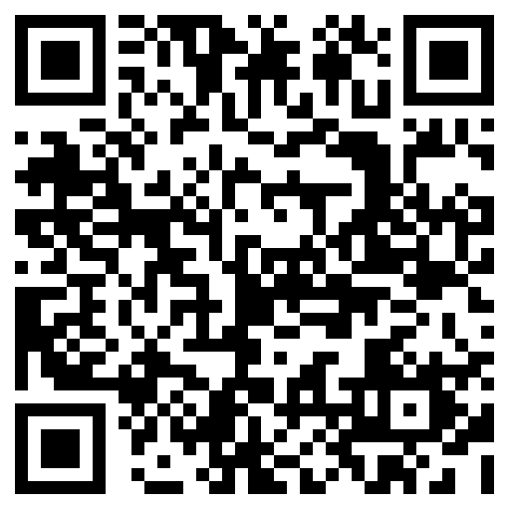
Group Discussion!
https://ahaslides.com/CRITERION1

